Slide 1
Comparisons in the SELECT statement
Data Manipulation Language

Slide 2
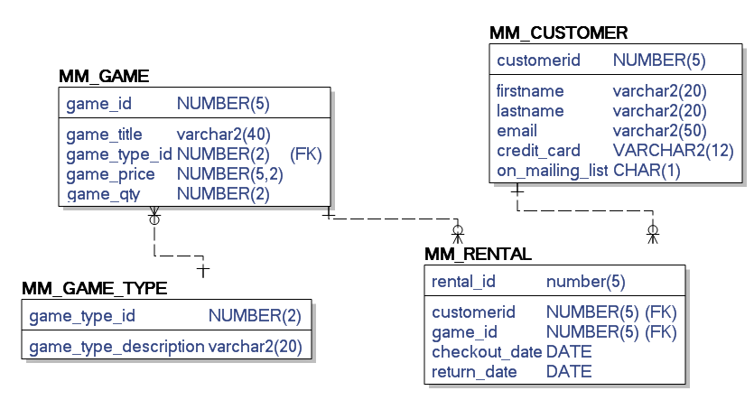
Our Game Shop From Last Week

Slide 3
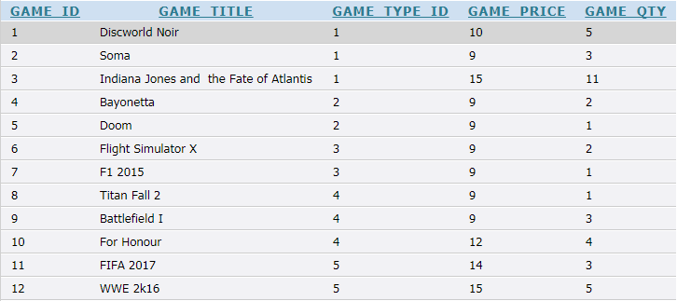
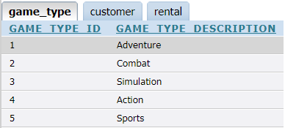
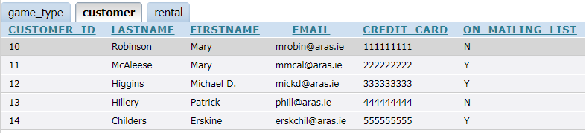
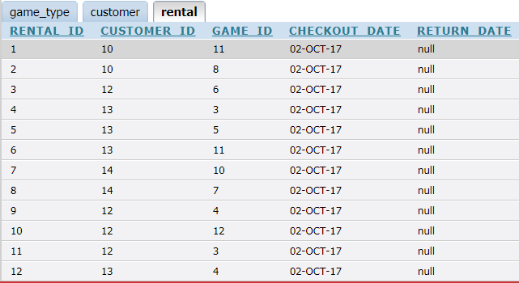

Slide 4
The basic SELECT statement revisited
SELECT columns FROM tables WHERE condition;
To use a select statement we need to know:
The pieces of data we want the DBMS to show us in the output once the SELECT statement is executed (columns)
The table(s) that the DBMS should look in to find those pieces of data (tables)
The condition we want the DBMS to use to filter the rows of data it uses to construct the output (showing the columns we have indicated for each row)(conditions)

Slide 5
How does it work?
The SELECT statement is a Query
For each Query the DBMS
Creates a temporary table
Its structure is the set of columns you have indicated
It populates it with values from the columns in the tables you indicated
If you have a where clause, it only inserts data that matches the condition you specify
If you run the SELECT as a single statement
Your output will be in the form of a table
If you run it as a Script
Your output will look like a report

Slide 6
Comparison Conditions
Operator | Meaning
= | Equal to
> | Greater than
>= | Greater than or equal to
< | Less than
<= | Less than or equal to
<> | Not equal to
BETWEEN ...AND... | Between two values (inclusive)
IN(set) | Match any of a list of values
LIKE | Match a character pattern
IS NULL | Is a null value
Notes:
Comparison Conditions
Comparison conditions are used in conditions that compare one expression to another value or expression. They are used in the WHERE clause in the following format:
Syntax
... WHERE expr operator value
Example
... WHERE hire_date = '01-JAN-95'
... WHERE salary >= 6000
... WHERE last_name = 'Smith'
An alias cannot be used in the WHERE clause.
Note: The symbols != and ^= can also represent the not equal to condition.

Slide 7
Simple Projection and Restriction
1
Find the price of the game called Soma
What table is needed?
What columns are needed?
What is the where clause?
Remember
Character strings and date values are enclosed by single quotation marks.
Character values are case-sensitive,
Date values are format-sensitive.
The default date format is DD-MON-RR.
SELECT <column names separated by commas>
FROM <table name>
WHERE <condition>;

Slide 8
Using Comparison Conditions
2
Find the title of all games with more than 3 in stock; include the quantity in the output
What table is needed?
What columns are needed?
What is the where clause?
SELECT columnname, columnname
FROM tablename
WHERE condition ;

Slide 9
Using the BETWEEN Condition
3
Use the BETWEEN condition to display rows based on a range of values.
Find the title of all games with quantities between 3 and 7 in stock; include the quantity in the output
SELECT colname, colname
FROM tablename
WHERE colname BETWEEN lowerlimit and upperlimit;

Slide 10
Using the IN Condition
4
Use the IN membership condition to test for values in a list.
Find the quantities between in stock for the following games Soma, Doom, Bayonetta; include the title in the output
SELECT colname, colname
FROM tablename
WHERE colname IN (value1, value2, value3, … valuen) ;
Notes:
Using the IN Condition
To test for values in a specified set of values, use the IN condition. The IN condition is also known as the membership condition.

Slide 11
Using the IN Condition
Use the IN membership condition to test for values in a list:
SELECT game_title, game_qty
FROM mm_game
WHERE game_qty IN (1,5,11);
Notes:
Using the IN Condition
To test for values in a specified set of values, use the IN condition. The IN condition is also known as the membership condition.
The slide example displays employee numbers, last names, salaries, and manager’s employee numbers for all the employees whose manager’s employee number is 100, 101, or 201.
The IN condition can be used with any data type. The following example returns a row from the EMPLOYEES table for any employee whose last name is included in the list of names in the WHERE clause:
SELECT employee_id, manager_id, department_id
FROM employees
WHERE last_name IN ('Hartstein', 'Vargas');
If characters or dates are used in the list, they must be enclosed by single quotation marks ('').

Slide 12
Using the LIKE Condition
5
Use the LIKE condition to perform wildcard searches of valid search string values.
Search conditions can contain a pattern with either literal characters or numbers:
% denotes zero or many characters.
_ denotes one character.
Find the titles of all games with a lower case letter o anywhere in its name
SELECT colname
FROM tablename
WHERE colname LIKE 'PATTERN';
Notes:
Using the LIKE Condition
You may not always know the exact value to search for. You can select rows that match a character pattern by using the LIKE condition. The character pattern–matching operation is referred to as a wildcard search. Two symbols can be used to construct the search string.

Slide 13
Using the LIKE Condition
6
Use the LIKE condition to perform wildcard searches of valid search string values.
Search conditions can contain a pattern with either literal characters or numbers:
% denotes zero or many characters.
_ denotes one character.
Find the titles of all games with a lower case letter o as the third letter of its name.
SELECT colname
FROM tablename
WHERE colname LIKE 'PATTERN';
Notes:
Using the LIKE Condition
You may not always know the exact value to search for. You can select rows that match a character pattern by using the LIKE condition. The character pattern–matching operation is referred to as a wildcard search. Two symbols can be used to construct the search string.

Slide 14
Using the LIKE Condition
You can use the ESCAPE identifier to search for the actual % and _ symbols.
Will return games with a title that contains T_
SELECT game_title
FROM mm_game
WHERE game_title LIKE '%T\_%' ESCAPE '\';
Notes:
Combining Wildcard Characters
The % and _ symbols can be used in any combination with literal characters. The example in the slide displays the names of all employees whose last names have the letter o as the second character.
ESCAPE Option
When you need to have an exact match for the actual % and _ characters, use the ESCAPE option. This option specifies what the escape character is. If you want to search for strings that contain ‘SA_’, you can use the following SQL statement:
SELECT employee_id, last_name, job_id
FROM employees WHERE job_id LIKE '%SA\_%' ESCAPE '\';
The ESCAPE option identifies the backslash (\) as the escape character. In the pattern, the escape character precedes the underscore (_). This causes the Oracle Server to interpret the underscore literally.

Slide 15
Using the NULL Conditions
7
Test for nulls with the IS NULL operator.
Find details of all rentals with a return date of null
SELECT *
FROM tablename
WHERE colname IS NULL ;
Notes:
Using the NULL Conditions
The NULL conditions include the IS NULL condition and the IS NOT NULL condition.
The IS NULL condition tests for nulls. A null value means the value is unavailable, unassigned, unknown, or inapplicable. Therefore, you cannot test with = because a null cannot be equal or unequal to any value.
…

Slide 16
Using the NULL Conditions
8
Test for non null values with the IS NOT NULL operator.
Find the rental id for all rentals with a value in their return date; include the return date in the output
SELECT rental_id, colname
FROM table
WHERE colname IS NOT NULL ;
Notes:
Using the NULL Conditions
The NULL conditions include the IS NULL condition and the IS NOT NULL condition.
The IS NULL condition tests for nulls. A null value means the value is unavailable, unassigned, unknown, or inapplicable. Therefore, you cannot test with = because a null cannot be equal or unequal to any value.
…

Slide 17
Logical Conditions
Operator | Meaning
AND | Returns TRUE if both component conditions are true
OR | Returns TRUE if either component condition is true
NOT | Returns TRUE if the following condition is false
Notes:
Logical Conditions
A logical condition combines the result of two component conditions to produce a single result based on those conditions, or it inverts the result of a single condition. A row is returned only if the overall result of the condition is true.
Three logical operators are available in SQL:
AND
OR
NOT
All the examples so far have specified only one condition in the WHERE clause. You can use several conditions in one WHERE clause using the AND and OR operators.

Slide 18
Using the AND Operator
9
AND requires both conditions to be true.
Find all titles with a lowercase letter o in their title with more than
3 in stock
Include the title and the quantity in the output
SELECT colname, colname
FROM tablename
WHERE condition
AND condition ;

Slide 19
Using the OR Operator
10
OR requires either condition to be true.
Find the titles of all games with a lowercase letter o in their title OR with 5 or more in stock
Include the title and the quantity in the output
SELECT colname, colname
FROM tablename
WHERE condition
OR condition;

Slide 20
Using the NOT Operator
11
NOT requires a condition to be FALSE.
Find the titles of all games that DO NOT have a price of 9, 10 or 12 using the IN operator
Include the title and the price in the output
SELECT colname, colname
FROM tablename
WHERE colnamae NOT IN (value1,value2,value3);

Slide 21
Rules of Precedence
Operator | Meaning
1 | Arithmetic operators
2 | Concatenation operator
3 | Comparison conditions
4 | IS [NOT] NULL, LIKE, [NOT] IN
5 | [NOT] BETWEEN
6 | Not equal to
7 | NOT logical condition
8 | AND logical condition
9 | OR logical condition
You can use parentheses to override rules of precedence.
Notes:
Rules of Precedence
The rules of precedence determine the order in which expressions are evaluated and calculated. The table lists the default order of precedence. You can override the default order by using parentheses around the expressions that you want to calculate first.

Slide 22
Rules of Precedence
12
SELECT game_title, game_qty
FROM mm_game
WHERE game_title like 'F%'
OR game_title like '_o%'
AND game_qty > 3;
1
How will this select statement be evaluated?
AND will be evaluated first
Then the OR

Slide 23
Rules of Precedence
13
SELECT game_title, game_qty
FROM mm_game
WHERE (game_title like 'F%‘
OR game_title like '_o%')
AND game_qty > 3;
2
How will this select statement be evaluated?
Parentheses control what is considered in the AND

Slide 24
ORDER BY Clause
14
Sort retrieved rows with the ORDER BY clause:
ASC: ascending order, default
DESC: descending order
The ORDER BY clause comes last in the SELECT statement.
Find the titles of all games where game type is 2 or 3 and sort in ascending order of game_type_id; include game_type_id in the output
SELECT colnames
FROM tablename
WHERE condition
ORDER BY colnames ASC;
SELECT colnames
FROM tablename
WHERE condition
ORDER BY colnames DESC;

Slide 25
SELECT game_title, game_qty from mm_game
ORDER BY game_qty DESC;
What will this SELECT statement return?

Slide 26
Using relationships to retrieve data with the SELECT statement
Data Manipulation Language

Slide 27
Retrieval from multiple tables in a single SELECT
Suppose we want to achieve the following
Return the names and categories of all games showing the name of the type rather than the ID
What do we need to do?
We know there is a relationship between these tables
We know that one attribute on the mm_game table holds values that are in the primary key attribute of the mm_game_type table
So how do we tell the SELECT statement to use this link

Slide 28
Inner Join
What are the pieces of data we want to get back?
Name of the game
Name of the type
Where are these pieces of data found?
MM_game
mm_game_type

Slide 29
Inner Join
How will we make sure that for each game we get the correct type?
Need to tell DBMS to use the value of type ID in the MM_game table to look up the mm_game_type table
Need to tell it which column is the link between the two
MM_game column is game_type_id
mm_game_type column is game_type_id
We already know these because we have used them to define our foreign keys

Slide 30
Inner Join
15
Return the names and categories of all games showing the name of the type rather than the ID
SELECT colname, colname
FROM table1
JOIN table2
USING (common colname);

Slide 31
Inner Join
16
Suppose we want to sort them in order of the type description
SELECT colname, colname
FROM table1
JOIN table2
USING (common colname)
ORDER BY colname ASC;

Slide 32
Inner Join
17
Suppose now we only wanted to find games from a type with the letter o somewhere in its name?
SELECT colname, colname
FROM table1
JOIN table2
USING (common colname)
WHERE condition;

Slide 33
Adding in a sort
And sort the output in order of game_title?
SELECT colname, colname
FROM table1
JOIN table2
USING (common colname)
WHERE condition
ORDER BY colname <direction>;

Slide 34
Adding in a sort
And sort the output in order of game_title?
SELECT game_title , game_type_description
FROM mm_game
JOIN mm_game_type
ON MM_game.game_type_id=mm_game_type.game_type_id
WHERE game_type_description like '%o%'
ORDER BY game_TITLE ASC;

Slide 35
Including a logical operator
Suppose now we only wanted to find games from a type with the letter o somewhere in its name or an a in its name and where the quantity is more than 3?
We want to return the title of the game, the name of the type and the quantity of the game

Slide 36
Including a logical operator
SELECT game_title , game_type_description , game_qty
FROM mm_game
JOIN mm_game_type
ON MM_game.game_type_id=mm_game_type.game_type_id
WHERE game_type_description like '%o%'
AND game_qty <3
ORDER BY game_TITLE ;

Slide 37
Inner Joins
Suppose we want to achieve the following
Return the check out date of each rental and the name of the game that has been rented
What do we need to do?

Slide 38
Inner Join
What are the pieces of data we want to get back?
Date of the rental (checkout_date)
Name of the game (game_title)
Where are these pieces of data found?
MM_RENTAL
MM_GAME
How will we make sure that for each game we get the correct title?
Need to tell DBMS to use the value of game_ID in the MM_RENTAL table to look up MM_GAME table
Need to tell it which column is the link between the two

Slide 39
Inner Join
What are the pieces of data we want to get back?
Date of rental
Name of the game
Where are these pieces of data found?
MM_RENTAL
MM_GAME
What are the column names?
CHECKOUT_DATE(MM_RENTAL)
GAME_TITLE(MM_GAME)

Slide 40
Inner Join
SELECT checkout_date, game_title
FROM MM_RENTAL
JOIN MM_GAME
USING (game_id);

Slide 41
Inner Join
Suppose now we only wanted to find games rented by a range of customers (those with IDs between 12 and 14)?
We want to return the title of the game, the date checked out, and the id of the customer

Slide 42
Using a Comparator
Suppose now we only wanted to find games rented by a range of customers (IDs between 12 and 14)?
SELECT checkout_date, game_title, customer_id
FROM mm_rental
JOIN mm_game
USING (game_id)
WHERE customer_id between 12 and 14;

Slide 43
Adding in a sort
And sort the output in descending order of game_title?

Slide 44
Adding in a sort
And sort the output in descending order of game_title?
SELECT checkout_date, game_title, customer_id
FROM mm_rental
JOIN mm_game
USING (game_id)
WHERE customer_id between 12 and 14
ORDER BY game_title DESC;

Slide 45
Including a logical operator
Suppose now we only wanted to find games with a qty of less than 3 borrowed by our customers between 12 and 14?
We want to return the title of the game, the checkout date, the customer ID and the quantity of the game

Slide 46
Including a logical operator
Suppose now we only wanted to find games with a qty of less than 3 borrowed by our members between 12 and 14?
We want to return the title of the game, the checkout date, the member ID and the quantity of the game
SELECT checkout_date, game_title, game_qty, customer_id
FROM mm_rental
JOIN mm_game
USING (game_id)
WHERE customer_id between 12 and 14
AND game_qty <3
ORDER BY game_title DESC;

Slide 47
Join mm_rental to two tables
18
We can join a table to more than one table in a select statement
Suppose we want to get the following details for each rental:
Customer name
Game title
Date checkedout
We need to join our rental table to both the game and the customer table to achieve it
Rental table is our main table since it holds the links to both of the other table
SELECT colname, colname, colname, colname
FROM maintable
JOIN table1 USING (colname common between maintable and table1)
JOIN table2 USING (colname common between maintable and table2);

Slide 48
How is the inner join working?

Slide 49
Suppose we have a table Sailor.
SELECT * FROM Sailor;
sid | sname | rating | age
22 | Dustin | 7 | 45.0
31 | Lubber | 8 | 55.5
58 | Rusty | 10 | 35
71 | Zorba | 10 | 16
74 | Horatio | 9 | 40
Sailor data

Slide 50
Suppose we have a related table containing details of boats reserved by sailors
Foreign key in Reservation is sid (sailor id) – link to Sailor table
SELECT * FROM Reservation;
sid | bid | day
22 | 101 | 10/10/02
58 | 103 | 11/12/02
Reservation data

Slide 51
Find the names of sailors who have reserved boat number 103.
SELECT sname
FROM Sailor
JOIN Reservation USING (sid)
WHERE bid = 103)
The corresponding
SQL query.
DB (2 tables)
sid | sname | rating | age
22 | Dustin | 7 | 45.0
31 | Lubber | 8 | 55.5
58 | Rusty | 10 | 35
sid | bid | day
22 | 101 | 10/10/02
58 | 103 | 11/12/02
Reservation table
IMPORTANT:
This specifies how the tables
are to be joined together.
Sailor Table
This query requires information from both tables.
To answer this query, a JOIN operation needs to be performed.

Slide 52
Find the names of sailors who have reserved boat number 103.
SELECT sname
FROM Sailor
JOIN Reservation USING (sid)
WHERE bid = 103);
Table 1
Overview:
A JOIN operation works as follows:
for each row in table sailor{
try to “join” with each row in reservation +
(match the “where” conditions)}
sid | sname | rating | age
22 | Dustin | 7 | 45.0
31 | Lubber | 8 | 55.5
58 | Rusty | 10 | 35
Analysis:
So, a JOIN takes O(nm) row operations
where n = size of table1, and m = size of table 2.
Table2
sid | bid | day
22 | 101 | 10/10/02
58 | 103 | 11/12/02

Slide 53
Find the names of sailors who have reserved boat number 103.
SELECT sname
FROM Sailor
JOIN Reservation USING (sid)
WHERE bid = 103)
DBMS
Sailor
Result
sailor.sid = 22
sid | sname | rating | age
22 | Dustin | 7 | 45.0
31 | Lubber | 8 | 55.5
58 | Rusty | 10 | 35
sname
reservation.sid = 22
(sailor.sid = reservation.sid)
reservation.bid = 101
(reservation.bid ≠ 103) !
Reservation
sid | bid | day
22 | 101 | 10/10/02
58 | 103 | 11/12/02
Condition is false
Do not output
this entry.

Slide 54
Q3. Find the names of sailors who have reserved boat number 103.
SELECT sname
FROM Sailor
JOIN Reservation USING (sid)
WHERE bid = 103)
DBMS
Sailor
Result
sailor.sid = 22
sid | sname | rating | age
22 | Dustin | 7 | 45.0
31 | Lubber | 8 | 55.5
58 | Rusty | 10 | 35
sname
reservation.sid = 58
(sailor.sid ≠ reservation.sid) !
Reservation
sid | bid | day
22 | 101 | 10/10/02
58 | 103 | 11/12/02
Condition is false
Do not output
this entry.

Slide 55
Find the names of sailors who have reserved boat number 103.
SELECT sname
FROM Sailor
JOIN Reservation USING (sid)
WHERE bid = 103)
DBMS
Sailor
Result
sailor.sid = 31
sid | sname | rating | age
22 | Dustin | 7 | 45.0
31 | Lubber | 8 | 55.5
58 | Rusty | 10 | 35
sname
reservation.sid = 22
(sailor.sid ≠ reservation.sid) !
Reservation
sid | bid | day
22 | 101 | 10/10/02
58 | 103 | 11/12/02
Condition is false
Do not output
this entry.

Slide 56
Find the names of sailors who have reserved boat number 103.
SELECT sname
FROM Sailor
JOIN Reservation USING (sid)
WHERE bid = 103)
DBMS
Sailor
Result
sailor.sid = 31
sid | sname | rating | age
22 | Dustin | 7 | 45.0
31 | Lubber | 8 | 55.5
58 | Rusty | 10 | 35
sname
reservation.sid = 58
(sailor.sid ≠ reservation.sid) !
Reservation
sid | bid | day
22 | 101 | 10/10/02
58 | 103 | 11/12/02
Condition is false
Do not output
this entry.

Slide 57
Find the names of sailors who have reserved boat number 103.
SELECT sname
FROM Sailor
JOIN Reservation USING (sid)
WHERE bid = 103)
DBMS
Sailor
Result
sailor.sid = 58
sid | sname | rating | age
22 | Dustin | 7 | 45.0
31 | Lubber | 8 | 55.5
58 | Rusty | 10 | 35
sname
reservation.sid = 22
(sailor.sid ≠ reservation.sid) !
Reservation
sid | bid | day
22 | 101 | 10/10/02
58 | 103 | 11/12/02
Condition is false
Do not output
this entry.

Slide 58
Find the names of sailors who have reserved boat number 103.
SELECT sname
FROM Sailor
JOIN Reservation USING (sid)
WHERE bid = 103)
DBMS
Sailor
Result
sailor.sid = 58
sid | sname | rating | age
22 | Dustin | 7 | 45.0
31 | Lubber | 8 | 55.5
58 | Rusty | 10 | 35
sname
reservation.sid = 58
Rusty
(sailor.sid = reservation.sid) !
reservation.bid = 103
(reservation.bid = 103) !
Reservation
sid | bid | day
22 | 101 | 10/10/02
58 | 103 | 11/12/02
Condition is true
Output this entry.

Slide 59
Find the names of sailors who have reserved boat number 103.
SELECT sname
FROM Sailor
JOIN Reservation USING (sid)
WHERE bid = 103)
DBMS
Sailor
Result
sid | sname | rating | age
22 | Dustin | 7 | 45.0
31 | Lubber | 8 | 55.5
58 | Rusty | 10 | 35
sname
Rusty
End of
Algorithm
Reservation
sid | bid | day
22 | 101 | 10/10/02
58 | 103 | 11/12/02

Slide 60
Summary
Result of SQL query requires
information from two tables
a JOIN operation is necessary
Joins are EXPENSIVE operations.

